Slide 1
7.8 Inverse of a Matrix.
Gauss–Jordan Elimination

Slide 2
7.8 Inverse of a Matrix.
Gauss–Jordan Elimination
In this section we consider square matrices exclusively.
The inverse of an n × n matrix A = [a_{jk}] is denoted by A⁻¹ and is an n × n matrix such that
(1) AA⁻¹ = A⁻¹A = I,
where I is the n × n unit matrix (see Sec. 7.2).
If A has an inverse, then A is called a nonsingular matrix; otherwise, A is called a singular matrix.
If A has an inverse, then the inverse is unique
  Proof: If both B and C are inverses of A, then AB = I and CA = I. Hence,
B = IB = (CA)B = C(AB) = CI = C.
Section 7.8 p<number>

Slide 3
7.8 Inverse of a Matrix.
Gauss–Jordan Elimination
A range of methods can be used to invert square matrices:
Gauss elimination: via elementary row operations
Cramer’s rule: by solving linear systems but we have yet to prove it left from section 7.7 …
Eigen decomposition: by transforming target matrix into diagonal forms thus easier to invert; we will study this further later in Eigen analysis of chapter 8
LU/Cholesky decomposition: by decomposing target matrix into triangular forms that are easier to invert
Numerical methods, e.g. Newton’s methods: iterative approaches, robust to rounding errors but also expensive
… ...
Section 7.8 p<number>

Slide 4
7.8 Inverse of a Matrix.
Gauss–Jordan Elimination
THEOREM 1
Existence of the Inverse
The inverse A⁻¹ of an n × n matrix A exists if and only if rank A = n, or (by Theorem 3, Sec. 7.7) if and only if det A ≠ 0.
Hence, A is nonsingular if rank A = n (inverse exists) and is singular if rank A < n (inverse does not exist)
Remark
If the inverse A⁻¹ exists, then Ax = b implies x = A⁻¹ b. However, we normally do not use this formula to solve linear system Ax = b numerically, as it requires more computations than Gauss elimination
Section 7.8 p<number>

Slide 5
Proof of THEOREM 1
7.8 Inverse of a Matrix.
Gauss–Jordan Elimination
Let A be the given n×n matrix and consider the linear system Ax=b. If the inverse A⁻¹ exists, then
x = I x = A⁻¹ A x = A⁻¹b.
Thus, the system has a unique solution. So rank A = n by Theorem 1 in Sec. 7.5.
Conversely, let rank A = n. Then, Ax=b has a unique solution for any vector b. Thus, we can find a unique matrix B such that
AB = I.
Similarly, since rank A^{T} = rank A = n, we have another unique matrix C such that A^{T}C = C^{T}A = I. Note that
C^{T} = C^{T}AB = I B = B.
Thus, AB = BA = I. By definition, B = A⁻¹ exists.
Section 7.8 p<number>

Slide 6
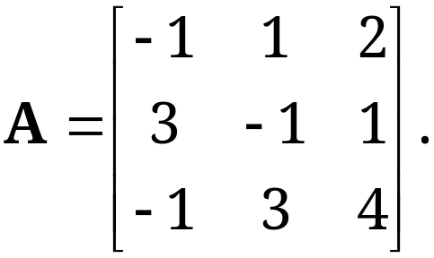
7.8 Inverse of a Matrix.
Gauss–Jordan Elimination
Determination of the Inverse by the Gauss–Jordan Method
EXAMPLE 1 Finding the Inverse of a Matrix
by Gauss–Jordan Elimination
Determine the inverse A⁻¹ of
Section 7.8 p<number>

Slide 7
7.8 Inverse of a Matrix.
Gauss–Jordan Elimination
Determination of the Inverse by the Gauss–Jordan Method (Why? and How it works??)
1. Transforming the inversion problem to solving a set of n linear systems of equations {Ax_{(i)} = e_{(i)}}, where e_{(i)} is the i^th column of n by n sized identity matrix I
2. Combine them into a single equation AX = I (X = A⁻¹)
3. Perform Gauss elimination on augmented matrix [A|I]
into upper triangular echelon form [U|H] and further until U becomes identity (if A is invertible) in [I|K]
4. Now we have an equivalent system IX = K and finally the inverse of A, A⁻¹ = K
Section 7.8 p<number>

Slide 8
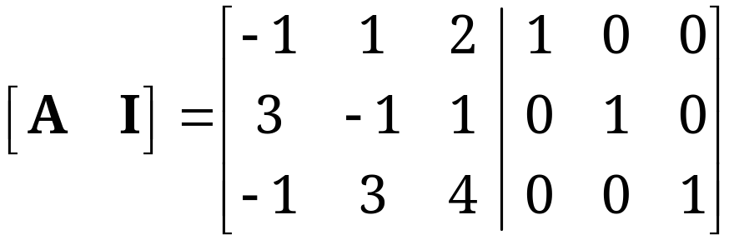


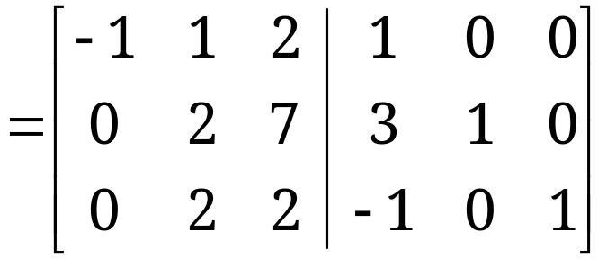

7.8 Inverse of a Matrix.
Gauss–Jordan Elimination
EXAMPLE 1 Finding the Inverse of a Matrix by Gauss–Jordan Elimination (continued)
Solution:
We apply the Gauss elimination to the following
n × 2n = 3 × 6 matrix:
Section 7.8 p<number>

Slide 9
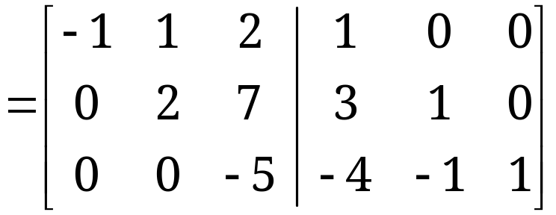



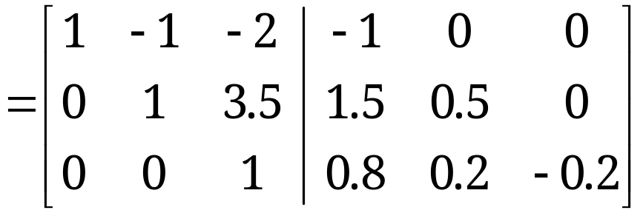


7.8 Inverse of a Matrix.
Gauss–Jordan Elimination
EXAMPLE 1 Finding the Inverse of a Matrix by Gauss–Jordan Elimination (continued)
Solution. (continued 1)
This is [U H] produced by the Gauss elimination.
Now follow the additional Gauss–Jordan steps and reduce U to the unit matrix I.
Section 7.8 p<number>

Slide 10
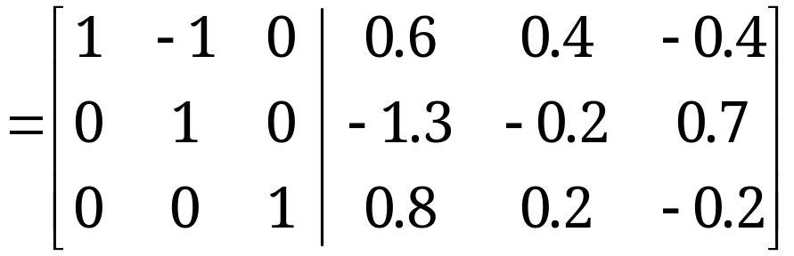

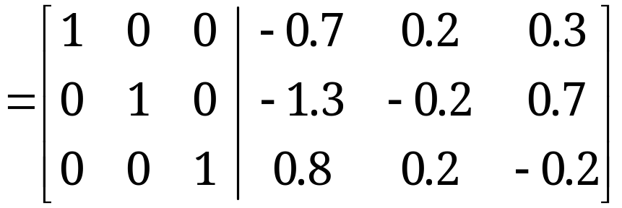
7.8 Inverse of a Matrix.
Gauss–Jordan Elimination
EXAMPLE 1 Finding the Inverse of a Matrix by Gauss–Jordan Elimination (continued)
Solution. (continued 2)
Section 7.8 p<number>

Slide 11
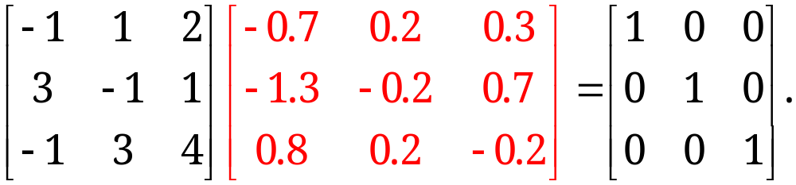
7.8 Inverse of a Matrix.
Gauss–Jordan Elimination
EXAMPLE 1 Finding the Inverse of a Matrix by Gauss–Jordan Elimination (continued)
Solution. (continued 3)
The last three columns constitute A⁻¹.
Check:
Hence, AA⁻¹ = I. Similarly, A⁻¹A = I.
Section 7.8 p<number>

Slide 12
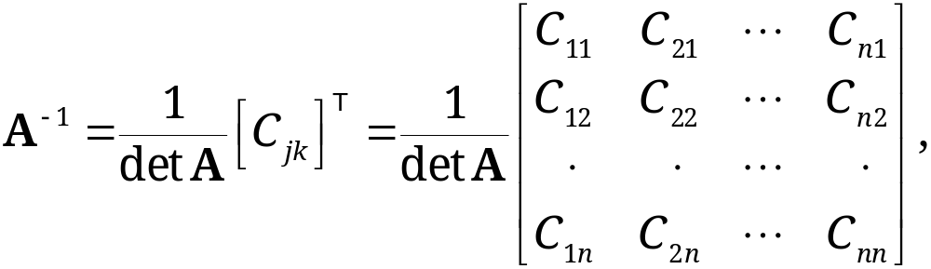
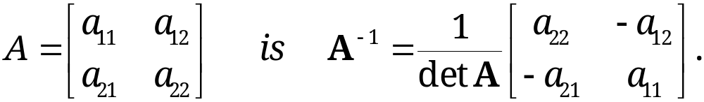
7.8 Inverse of a Matrix.
Gauss–Jordan Elimination
THEOREM 2
Inverse of a Matrix by Determinants
The inverse of a nonsingular n × n matrix A = [a_{jk}] is given by
(4)
where C_{jk} is the cofactor of a_{jk} in det A. (Note: in A⁻¹, the cofactor C_{jk} occupies the same place as a_{kj} (NOT a_{jk}!) does in A.)
In particular, the inverse of
(4*)
Section 7.8 p<number>

Slide 13
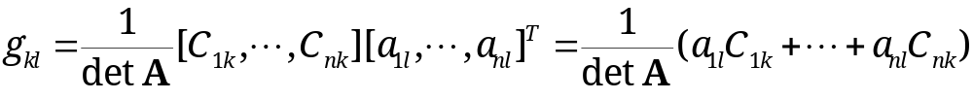
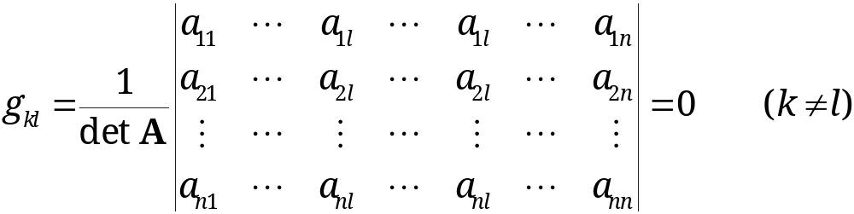
Proof of THEOREM 2
7.8 Inverse of a Matrix.
Gauss–Jordan Elimination
We denote the right side of (4) by B and show that BA = I. We now write BA = G and then show that G = I.
(5) BA = G = [g_{kl}]
By matrix multiplication and the form of B in (4), we have
(6)
When k=l, it follows from the definition of determinant that g_{kk}=1. If k≠l, g_{kl} contains identical/proportional columns, via Theorem 2(f) in section 7.7, we have g_{kl} =0, and G = I.
Section 7.8 p<number>

Slide 14
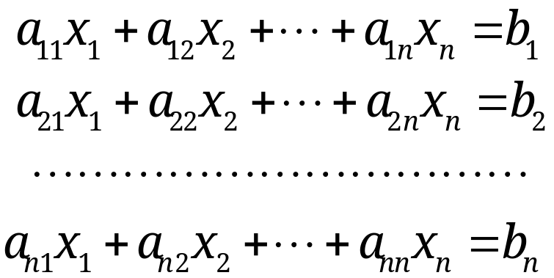
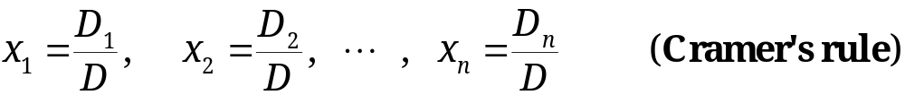
Application of Theorem 2
Proof of Cramer’s Rule
7.7 Determinants. Cramer’s Rule
Cramer’s Theorem (Solution of Linear Systems by Determinants)
If a linear system of n equations in n unknowns x₁, … , x_{n}
(6)
has a coefficient matrix A with D = det A ≠ 0, then the
system has a unique solution.
Section 7.7 p<number>

Slide 15
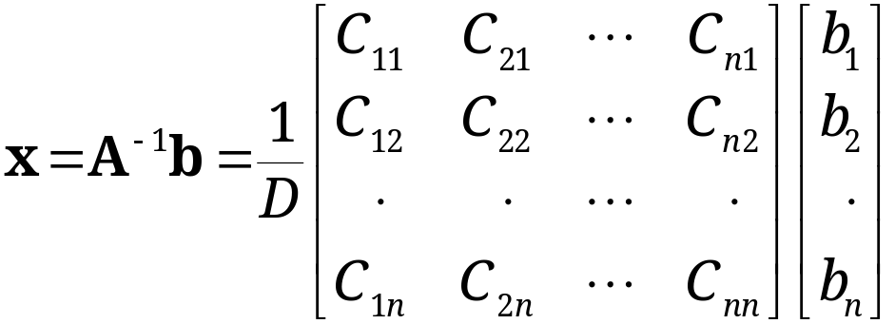
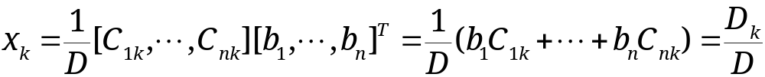
Application of Theorem 2
Proof of Cramer’s Rule
7.8 Inverse of a Matrix.
Gauss–Jordan Elimination
When D = det A ≠ 0, matrix A has an inverse A⁻¹. Thus, the solution to Ax = b is given by
Hence, for k=1, ∙ ∙ ∙, n,
where D_{k} is the determinant obtained from D by replacing the kth column of D by the column with entries b₁, ∙ ∙ ∙, b_{n}.
Section 7.8 p<number>

Slide 16
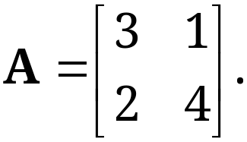
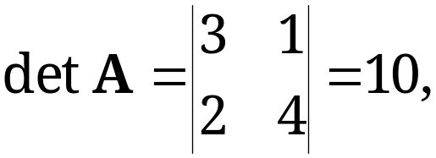
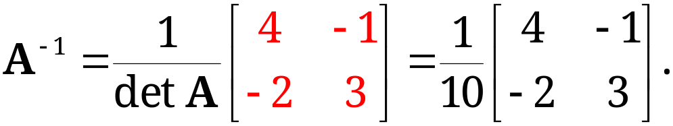
7.8 Inverse of a Matrix.
Gauss–Jordan Elimination
EXAMPLE 2 Inverse of a 2 × 2 Matrix by Determinants
Find the inverse of the following matrix by determinants
Solution:
From (4*), we have
and
Section 7.8 p<number>

Slide 17
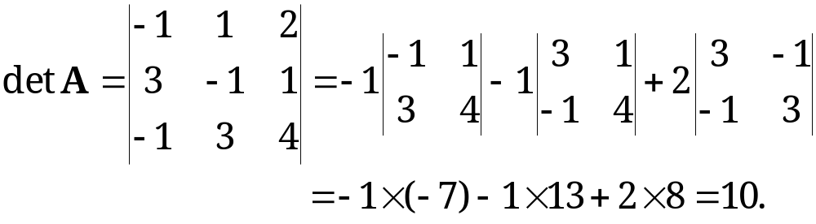
7.8 Inverse of a Matrix.
Gauss–Jordan Elimination
EXAMPLE 3 Further Illustration of Theorem 2
Using (4), find the inverse of
Solution:
We first calculate det A:
Section 7.8 p<number>

Slide 18
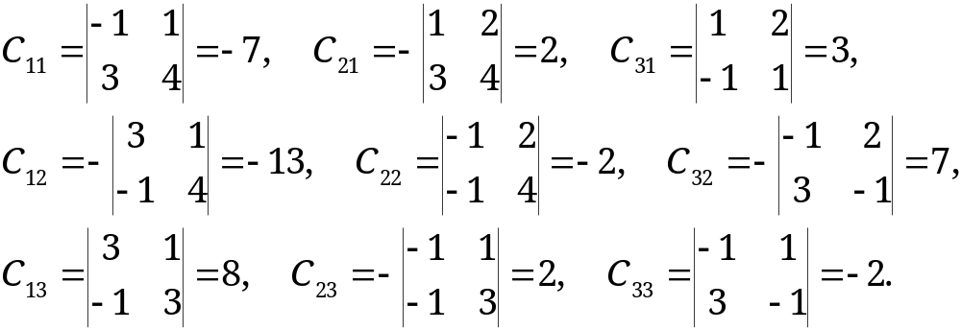
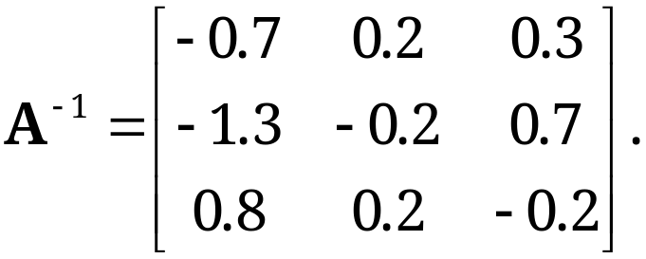
7.8 Inverse of a Matrix.
Gauss–Jordan Elimination
EXAMPLE 3 Further Illustration of Theorem 2 (continued)
We next calculate the cofactor C_{jk}, j, k=1, 2, 3
Using (4), we have (the same as Example 1)
Section 7.8 p<number>

Slide 19
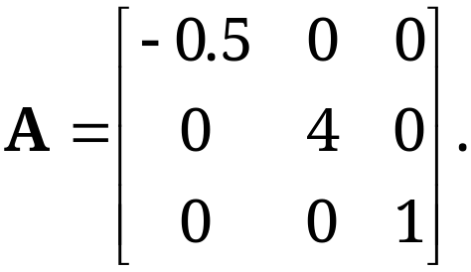
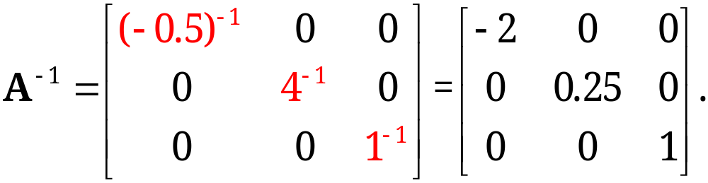
7.8 Inverse of a Matrix.
Gauss–Jordan Elimination
Diagonal matrix A = [a_{jk}], a_{jk} =0 when j≠k, has an inverse if and only if all a_{jj} ≠ 0. Then, A⁻¹ is diagonal too, with entries 1/a₁₁, ∙ ∙ ∙ , 1/a_{nn}.
EXAMPLE 4 Inverse of a Diagonal Matrix
Let
Then, A⁻¹ is given by
Section 7.8 p<number>

Slide 20
7.8 Inverse of a Matrix.
Gauss–Jordan Elimination
Products can be inverted by taking the inverse of each factor and multiplying these inverses in the reverse order,
(7) (AC)⁻¹ = C⁻¹A⁻¹.
For more than two factors, we have
(8) (AC … PQ)⁻¹ = Q⁻¹P⁻¹ … C⁻¹A⁻¹.
Proof. Directly check that
(AC)C⁻¹A⁻¹ = I = C⁻¹A⁻¹(AC).
Thus, by definition of inverse, (7) holds. (8) follows from (7) by induction.
Note. The inverse of the inverse is the given matrix, i.e.,
(9) (A⁻¹)⁻¹ = A.
Section 7.8 p<number>

Slide 21
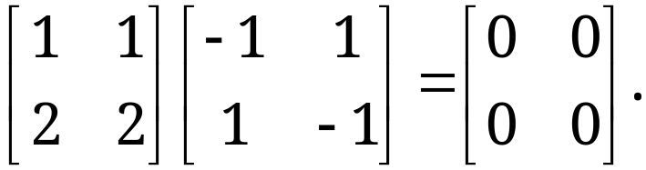
7.8 Inverse of a Matrix.
Gauss–Jordan Elimination
Unusual Properties of Matrix Multiplication. Cancellation Laws
Matrix multiplication is not commutative, that is, in general we have
AB ≠ BA.
AB = 0 does not generally imply A = 0 or B = 0
(or BA = 0); for example,
AC = AD does not generally imply C = D (even when A ≠ 0).
Section 7.8 p<number>

Slide 22
7.8 Inverse of a Matrix.
Gauss–Jordan Elimination
THEOREM 3
Cancellation Laws
Let A, B, C be n × n matrices. Then:
(a) If rank A = n and AB = AC, then B = C.
(b) If rank A = n, then AB = 0 implies B = 0. Hence if AB = 0, but A ≠ 0 and B ≠ 0, then rank A < n and rank B < n.
(c) If A is singular (no inverse exists), so are BA and AB.
Section 7.8 p<number>

Slide 23
7.8 Inverse of a Matrix.
Gauss–Jordan Elimination
Proof of THEOREM 3
Proof of (a): Since rank A = n, the inverse of A exists by Theorem 1. Multiplication by A⁻¹, we have
B = A⁻¹AB=A⁻¹AC=C.
Thus, (a) holds.
Proof of (b): It simply follows from B = A⁻¹AB=A⁻¹0 =0.
Proof of (c): A is singular implies that Ax=0 has nontrivial solutions by Theorem 2 in Sec. 7.5. Note that any solution to Ax=0 is also a solution to (BA)x=0. Thus,
nullity A ≤ nullity BA.
Hence, rank BA ≤ rank A<n. So BA is singular by Theorem 1. That AB is singular follows from rank AB = rank B^{T}A^{T} ≤ rank A^{T} = rank A<n.
Section 7.8 p<number>

Slide 24
7.8 Inverse of a Matrix.
Gauss–Jordan Elimination
Determinants of Matrix Products
THEOREM 4
Determinant of a Product of Matrices
For any n × n matrices A and B,
(10) det (AB) = det (BA) = det A × det B.
For more than two matrices, we can iteratively induct and generalize to
det (ABC … PQ) = det A × det B × … × det P × det Q.
Note: see page 308 of textbook for detailed proof of Theorem 4.
Section 7.8 p<number>

Slide 25
7.8 Inverse of a Matrix.
Gauss–Jordan Elimination
Determinants of Matrix Products
THEOREM 4 (Proof)
Determinant of a Product of Matrices
(10) det (AB) = det (BA) = det A × det B.
For any n × n matrices A and B, one can use determinant preserving elementary row operations in Theorem 1(b) in section 7.7 to transform [AB] to [D_{diag}H] and
det(AB) = det(D_{diag}H).
Note: Addition of a multiple of a row to another row does not alter the value of the determinant
Section 7.8 p<number>

Slide 26
7.8 Inverse of a Matrix.
Gauss–Jordan Elimination
Determinants of Matrix Products
THEOREM 4 (Proof)
Determinant of a Product of Matrices
(10) det (AB) = det (BA) = det A × det B.
Following Theorem 1(c) in section 7.7, it can be shown than
det(AB) = det(D_{diag}H) = det(D_{diag}) × det(H)
The same proof also holds communicatively for BA
Note: Multiplication of a row by a nonzero constant c multiplies the value of the determinant by c
Section 7.8 p<number>

Slide 27
7.9 Vector Spaces, Inner Product Spaces, Linear Transformations

Slide 28
7.4 Linear Independence. Rank of a Matrix. Vector Space
Vector Space: Review
Consider a nonempty set V of vectors (of same size). V is called a vector space if the following 1) – 3) are satisfied:
For any two vectors a and b in V, all their linear combinations αa + βb (where α, β are any real numbers) are also in V;
Addition between vectors a, b, c in V satisfies
  a + b = b + a (commutative rule)
  (a + b) + c = a + (b + c) (associative rule)
  a + 0 = a (Existence of 0 vector)
  a + (-a) = 0 (Existence of (-a) vector)
Scalar multiplication of vectors a, b in V satisfies
  c(a + b) = ca + cb c and k are any real numbers
  (c+k)a = ca + ka
  c(ka) = (ck)a
  1a = a
Section 7.4 p<number>

Slide 29
7.4 Linear Independence. Rank of a Matrix. Vector Space
Dimension and Basis
The maximum number of linearly independent vectors in V is called the dimension of V and is denoted by dim V
A linearly independent set in V consisting of a maximum possible number of vectors in V is called a basis for V
  Any largest possible set of linearly independent vectors in V forms basis for V
  If we add one or more vectors to the basis, then it will become linearly dependent.
  Any vector in V can be expressed as a linear combination of a basis in V.
The number of vectors of a basis for V equals dim V
Section 7.4 p<number>

Slide 30
7.9 Vector Spaces, Inner Product
Spaces, Linear Transformations
DEFINITION
Real Vector Space
Instead of producing vector spaces via spans, or linear vector combination, we can generalize the idea by taking all n-real number vectors obtain a real n-dimensional vector space
A nonempty set V of elements a, b, ∙ ∙ ∙ is called a real vector space (or real linear space), and these elements are called vectors (regardless of their nature) if, in V, there are two algebraic operations defined as follows:
I. Vector addition. It maps every pair of vectors a and b in V to a unique vector in V, called the sum of a and b and denoted by a + b, such that the following axioms are satisfied:
Section 7.9 p<number>

Slide 31
7.9 Vector Spaces, Inner Product
Spaces, Linear Transformations
DEFINITION (continued)
Real Vector Space (continued 1)
I.1 Commutativity. For any two vectors a and b in V,
a + b = b + a.
I.2 Associativity. For any three vectors a, b, c in V,
(a + b) + c = a + (b + c) (written a + b + c).
I.3 Existence of zero vector. There is a unique vector in V, called the zero vector and denoted by 0, such that for every a in V,
a + 0 = a.
I.4 Existence of negative vector. For every vector a in V, there exists a unique vector in V, denoted by −a, such that
a + (−a) = 0.
Section 7.9 p<number>

Slide 32
7.9 Vector Spaces, Inner Product
Spaces, Linear Transformations
DEFINITION (continued)
Real Vector Space (continued 2)
II. Scalar multiplication. The real numbers are called scalars. Scalar multiplication maps every a in V and every scalar c to a unique vector in V, called the product of c and a and denoted by ca, such that the following axioms are satisfied:
II.1 Distributivity. For every scalar c and vectors a and b in V,
c(a + b) = ca + cb.
II.2 Distributivity. For all scalars c and k and every a in V,
(c + k)a = ca + ka.
II.3 Associativity. For all scalars c and k and every a in V,
c(ka) = (ck)a (written cka).
II.4 For every a in V,
1a = a.
Section 7.9 p<number>

Slide 33
7.9 Vector Spaces, Inner Product
Spaces, Linear Transformations
In the above definition, if we take complex numbers as scalars instead of real numbers, we obtain the axiomatic definition of a complex vector space
The following concepts related to a vector space are exactly defined as those given in Sec. 7.4
  Linear combination of vectors a₁, ∙ ∙ ∙, a_{m} in a vector space V is an expression
  c₁a₁+ ∙ ∙ ∙ + c_{m}a_{m} (where c₁ , ∙ ∙ ∙, c_{m} are scalars).
  These vectors are linearly independent if
  c₁a₁+ ∙ ∙ ∙ + c_{m}a_{m} = 0
  implies c₁=∙ ∙ ∙= c_{m}=0; otherwise, they are linearly dependent
  V has dimension n or is n-dimensional if the maximum number of linearly independent vectors in V is n. That set of linearly independent vectors is called a basis for V
Section 7.9 p<number>

Slide 34
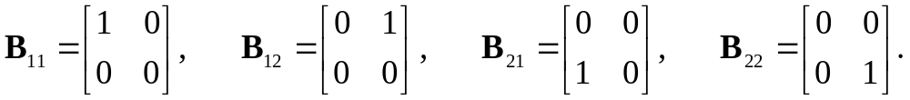
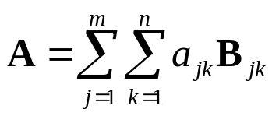
7.9 Vector Spaces, Inner Product
Spaces, Linear Transformations
EXAMPLE 1 Vector Space of Matrices
All real 2×2 matrices form a four-dimensional real vector space. A basis is
This is because any 2×2 matrix A = [a_{jk}] can be written as
A = a₁₁B₁₁+ a₁₂B₁₂ + a₂₁B₂₁ + a₂₂B₂₂.
Similarly, all real m×n matrices form an mn-dimensional vector space, since
where B_{jk} is an m×n matrix with the (jk)-th entry being one and all other entries being zero
Section 7.9 p<number>

Slide 35
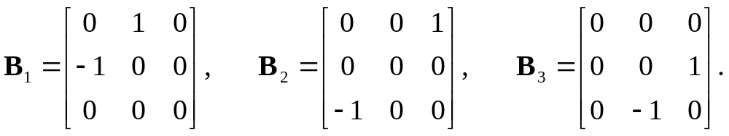
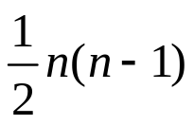
7.9 Vector Spaces, Inner Product
Spaces, Linear Transformations
EXERCISE 1
Question: Do all real 3×3 skew-symmetric matrices form a vector space? If so, find its dimension and a basis.
Solution
  Yes, they form a vector space, because any linear combination of two skew-symmetric matrices is still a skew-symmetric matrix
  It has 3 dimensions; and a basis is given by
What is the dimension of all real n×n skew-symmetric matrices?
Section 7.9 p<number>

Slide 36


7.9 Vector Spaces, Inner Product
Spaces, Linear Transformations
EXAMPLE 2 Vector Space of Polynomials
The set of all constant, linear, and quadratic polynomials in x together is a vector space of 3 dimensions with basis
under the usual addition and multiplication by real numbers because these two operations give polynomials of degree at most 2
Question: what is the dimension of the vector space of all polynomials of degree at most n? Can you find a basis?
  Solution: the dimension is n+1. A basis is given by
Section 7.9 p<number>

Slide 37
7.9 Vector Spaces, Inner Product
Spaces, Linear Transformations
Linear Transformations
Let X and Y be any vector spaces.
A mapping (or transformation or operator) of X into Y defines for any vector x in X a unique vector y in Y.
A mapping is denoted by a capital letter, say F.
The corresponding vector y in Y is called the image of x under F and is denoted by F(x).
F
y
x
X
Y
Section 7.9 p<number>

Slide 38
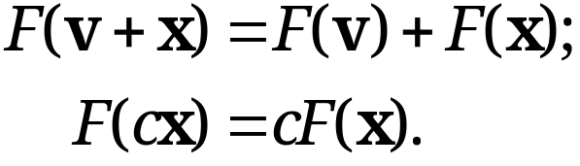
7.9 Vector Spaces, Inner Product
Spaces, Linear Transformations
Linear Transformations
DEFINITION
A mapping F is called a linear mapping or linear transformation if, for all vectors v and x in X and scalar c, the following two equalities hold:
(10)
Section 7.9 p<number>

Slide 39
7.9 Vector Spaces, Inner Product
Spaces, Linear Transformations
Linear Transformation of Space R^{n} into Space R^{m}
Let X = R^{n} and Y = R^{m}. Then, any real m × n matrix A = [a_{jk}] gives a transformation of R^{n} into R^{m},
(11) y = Ax.
Since A(u + x) = Au + Ax and A(cx) = cAx, it is a linear transformation.
Conversely, every linear transformation F of R^{n} into R^{m} can be given in terms of an m × n matrix A, after a basis for R^{n} , {e_{(i=1,..,n)}}, and a basis for R^{m} , {e_{(i=1,..,m)}}, are chosen.
Detailed proof on page 314 of the text book
Section 7.9 p<number>

Slide 40
7.9 Vector Spaces, Inner Product
Spaces, Linear Transformations
Linear Transformation of Space R^{n} into Space R^{m}
Proof:
By definition any vector in space R^{n} is obtained as
x = x₁e₍₁₎ + x₂e₍₂₎+ … + x_{n}e_{(n),}
and following a linear transformation F’s linearity, we have
F(x) = F(x₁e₍₁₎ + x₂e₍₂₎+ … + x_{n}e_{(n)})
= x₁F(e₍₁₎) + x₂F(e₍₂₎ )+ … + x_{n}F(e_{(n)}),
thus simplifying the problem to only proving the linear mapping F(e_{(i)}) exists for standard basis {e_{(i=1,..,n)}}.
Section 7.9 p<number>

Slide 41
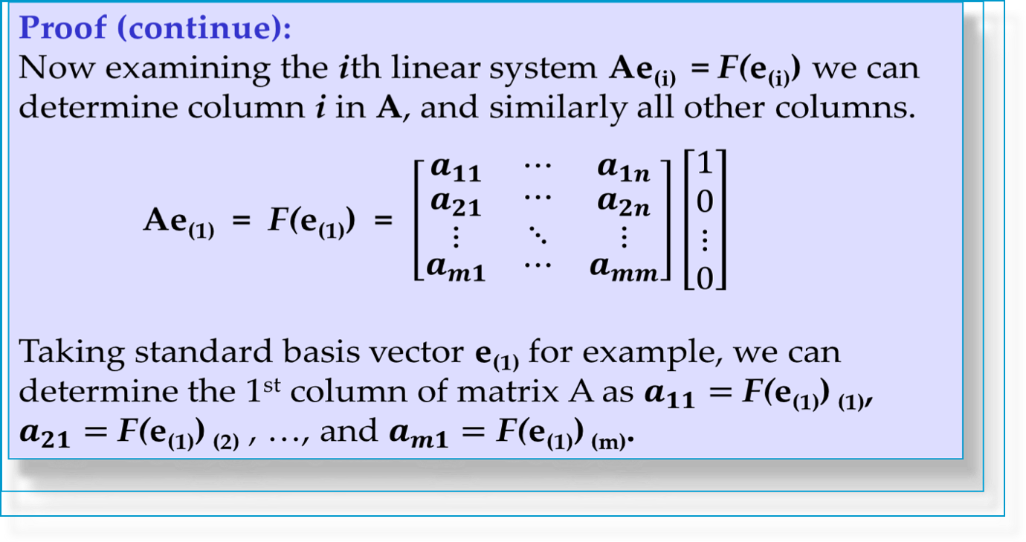
7.9 Vector Spaces, Inner Product
Spaces, Linear Transformations
Linear Transformation of Space R^{n} into Space R^{m}
n
Section 7.9 p<number>

Slide 42
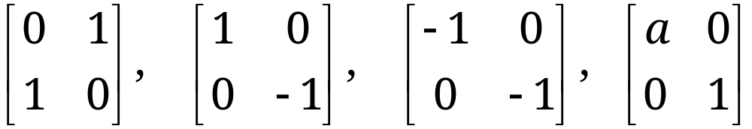
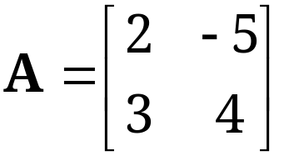
7.9 Vector Spaces, Inner Product
Spaces, Linear Transformations
EXAMPLES 5 & 6 Linear Transformations
Interpreted as transformations of Cartesian coordinates in the plane, the matrices
represent 1) a reflection in the line x₂=x₁; 2) a reflection in the x₁-axis; 3) a reflection in the origin; and 4) a stretch in the x₁ -direction, respectively
Question: find A representing the linear transformation that maps point (x₁, x₂) onto point (2x₁-5x₂, 3x₁+4x₂)
  Solution:
Section 7.9 p<number>

Slide 43
7.9 Vector Spaces, Inner Product
Spaces, Linear Transformations
Inverse Transformation
If A in (11) is an n × n matrix, then (11) maps R^{n} into R^{n}. If A is nonsingular, so that A⁻¹ exists, then multiplication of (11) by A⁻¹ gives the inverse transformation
(14) x = A⁻¹ y.
It maps every y = y₀ onto that x, which by (11) is mapped onto y₀
The inverse of a linear transformation is itself linear, because it is given by a matrix, as (14) shows.
Section 7.9 p<number>

Slide 44
7.9 Vector Spaces, Inner Product
Spaces, Linear Transformations
Composition of Linear Transformations
Let X, Y, W be general vector spaces.
G is a linear transformation from W to X; and F is a linear transformation from X to Y.
H, the linear transformation from W to Y, is called the composition of F and G,
H = F ◦ G = FG = F(G).
G
F
x
y
w
X
W
Y
H
Section 7.9 p<number>

Slide 45
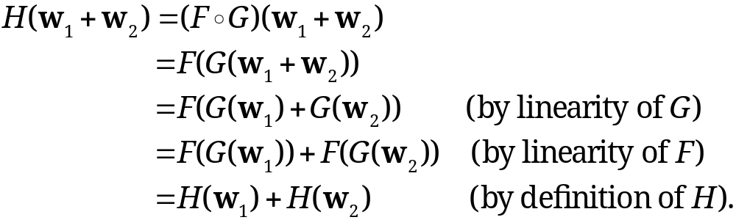
7.9 Vector Spaces, Inner Product
Spaces, Linear Transformations
EXAMPLE 7
The Composition of Linear Transformation Is Linear
To show that H is a linear transformation, we need to show that (10) holds. We have, for two vectors, w₁, w₂ in W,
Similarly, H(cw₂) = F(G(cw₂)) = F(cG(w₂)) = cF(G(w₂)) = c H(w₂). Thus, (10) holds and H is a linear transformation.
Section 7.9 p<number>

Slide 46
7.9 Vector Spaces, Inner Product
Spaces, Linear Transformations
Composition of Linear Transformations as Matrix Multiplication
Let W=R^{p}, X=R^{n}, Y=R^{m}. Thus, F can be represented by a general real m×n matrix A=[a_{jk}] and G by an n×p matrix B=[b_{jk}].
Then, we can write for F, with column vector x with n entries, and resulting vector y, with m entries
y=Ax;
and similarly for G, with column vector w with p entries,
x=Bw.
Therefore,
y = Ax = A (Bw) = (AB) w =Cw, where C=AB.
Thus, we can define the composition of linear transformations in the Euclidean spaces as multiplication by matrices.
Section 7.9 p<number>

